Slide 1

AI-Driven Revenue Analysis using Power BI
Guided By : Kalaivani A
Presented By : Krithika Aggarwal
Mucherla Rajender Reddy
Mehana
Vaishali

Slide 2
INTRODUCTION
The Hotel Revenue Management Dashboard is a Business Intelligence solution developed using Power BI to analyze hotel performance through structured data modeling and interactive visualizations.
The system integrates booking data, guest demographics, revenue details, and cancellation trends into a centralized dashboard.
Key performance indicators such as:
Total Revenue
Profit
ADR (Average Daily Rate)
RevPAR
Occupancy Rate
Cancellation Rate are calculated using DAX and displayed through interactive visuals.

Slide 3
PROBLEM STATEMENT
Hotels face challenges such as:
Fluctuating seasonal demand
High cancellation rates
Unclear revenue contribution by segments
Traditional reporting methods fail to provide:
Real-time insights
Predictive analysis
Guest-level segmentation
Strategic revenue visibility

Slide 4
OBJECTIVES
Develop a structured data model using Power BI
Calculate KPIs like ADR, RevPAR, Profit, Cancellation Rate
Analyze revenue across cities and properties
Study guest demographics and loyalty contribution
Identify cancellation patterns
Implement revenue forecasting
Provide strategic decision-support insights

Slide 5
REQUIREMENT ANALYSIS
Software Requirements
Microsoft Power BI Desktop
Microsoft Excel
Power Query
Windows 64-bit OS
Power BI Service (Deployment)
Hardware Requirements
Intel i5 Processor or above
Minimum 8GB RAM (16GB recommended)
10GB Free Storage

Slide 6
SYSTEM ARCHITECTURE
Architecture Flow:
Data Source (Excel Dataset) ⬇ Data Cleaning (Power Query) ⬇ Data Modeling (Fact & Dimension Tables) ⬇ DAX Calculations (KPIs & Measures) ⬇ Visualization Layer (5 Modules Dashboard) ⬇ Decision Support & Forecasting

Slide 7
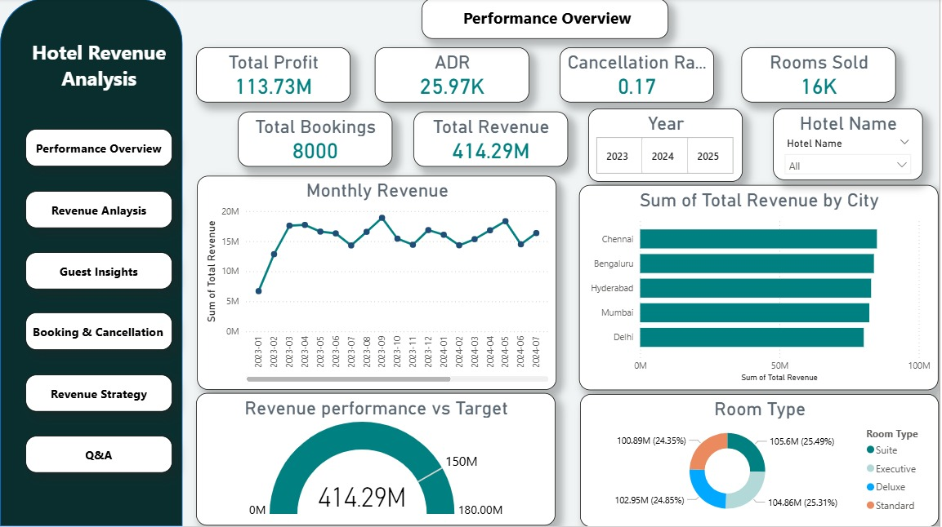
MODULE 1 – REVENUE OVERVIEW
This module provides a consolidated summary of overall financial performance.
Key Metrics:
Total Profit , Total Bookings , Rooms Sold
Visuals:
Monthly Revenue Trend (Line Chart)
Revenue by City (Bar Chart)
Revenue vs Target (Gauge)
Revenue by Room Type (Donut Chart)
Insights:
Revenue shows seasonal peaks
Southern cities contribute higher revenue
Balanced room-type contribution

Slide 8
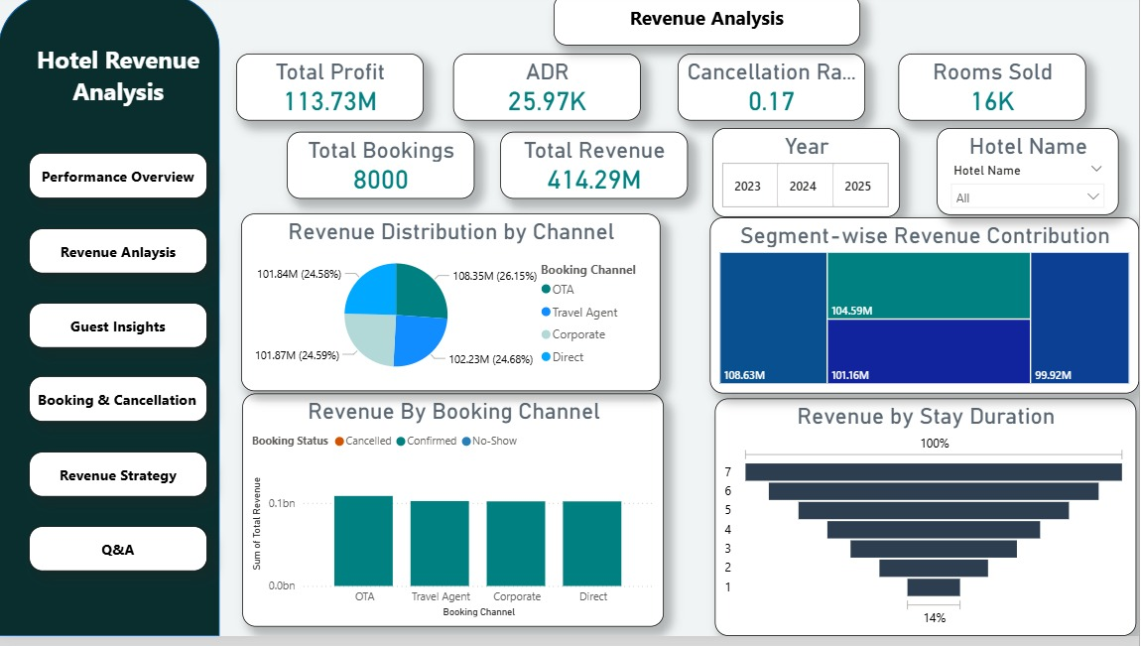
MODULE 2 – OCCUPANCY & REVENUE METRICS
This module analyzes booking sources and revenue contribution.
KPIs:
Total Revenue , ADR , Maximum Revenue
Visuals:
Revenue by Booking Channel
Segment-wise Revenue (Treemap)
Revenue by Stay Duration (Funnel Chart)
Channel Distribution (Donut Chart)
Insights:
OTA and Travel Agents generate higher revenue
Balanced multi-channel distribution

Slide 9
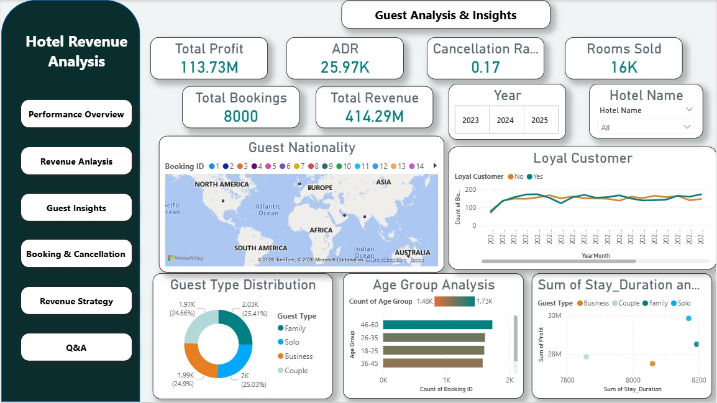
MODULE 3 – GUEST ANALYSIS
This module focuses on customer demographics and loyalty impact.
KPI:
Loyal Customer Revenue
Visuals:
Guest Nationality Map
Guest Type Distribution
Loyal Revenue Trend
Stay Duration vs Profit (Scatter Plot)
Insights:
Strong loyal customer contribution
Middle-aged professionas dominate bookings

Slide 10
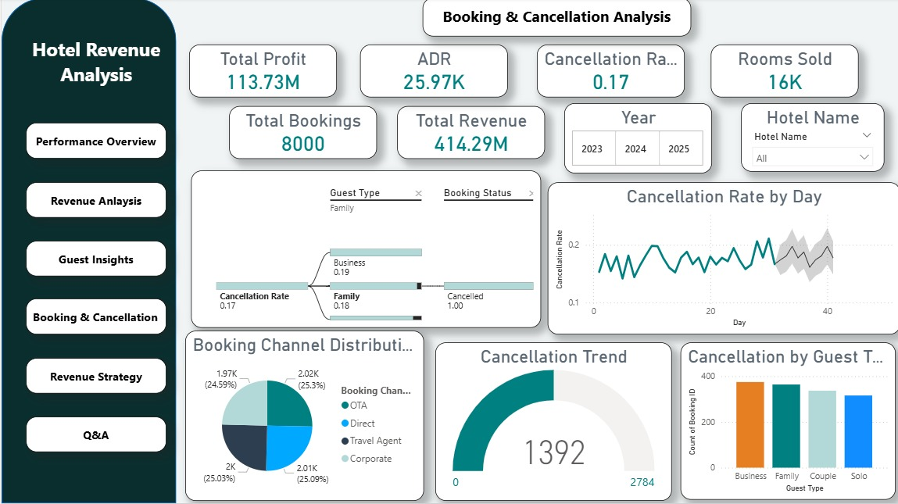
MODULE 4 – FORECASTING & CANCELLATION ANALYSIS
This module evaluates booking risks and cancellation behavior.
KPIs:
Cancelled Bookings , Cancellation Rate
Visuals:
Cancellation Rate Trend (Line Chart)
Cancellation by Guest Type (Bar Chart)
Channel-wise Cancellation (Donut Chart)
Decomposition Tree
Insights:
Cancellation rate fluctuates between 15–22%
Business and Family segments show higher cancellations

Slide 11
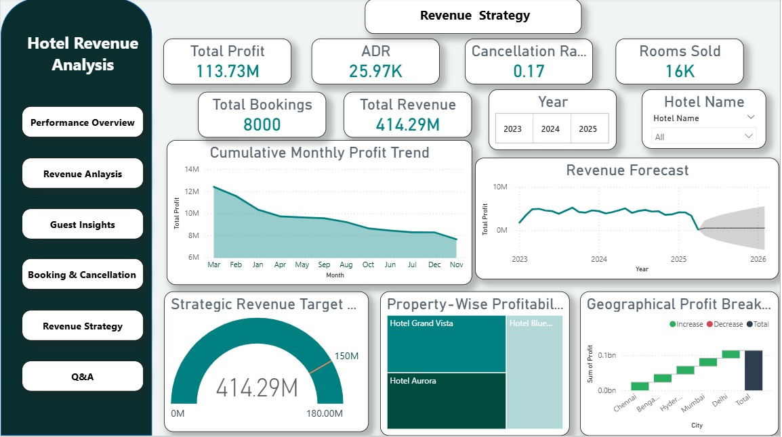
MODULE 5 – REVENUE STRATEGY
This module provides advanced strategic insights.
KPIs:
Upsell Index , Strategic Revenue Target
Visuals:
Cumulative Profit Trend (Area Chart)
Target vs Actual Gauge
Property-wise Profitability (Treemap)
Geographical Profit Breakdown (Waterfall Chart)
Insights:
Revenue significantly exceeds strategic target
Forecast predicts stable future growth

Slide 12
TESTING & IMPLEMENTATION
Testing Conducted
Data validation testing
DAX formula validation
Filter & slicer testing
KPI accuracy verification
Forecast testing
Implementation
Developed in Power BI Desktop
Data cleaned using Power Query
Measures created using DAX
Dashboard published to Power BI Service

Slide 13

FUTURE ENHANCEMENTS
Integrate Machine Learning models for advanced forecasting
Real-time booking engine integration
Dynamic pricing recommendation system
Sentiment analysis from guest reviews
Automated alert system for high cancellation
Multi-chain hotel scalability

Slide 14

CONCLUSION
The Hotel Revenue Management Dashboard successfully demonstrates the power of Business Intelligence in the hospitality industry.
By integrating:
Revenue analytics
Guest segmentation
Cancellation tracking
Forecasting models
The system provides actionable insights for pricing
optimization, marketing strategy, and operational efficiency.

